Slide 1
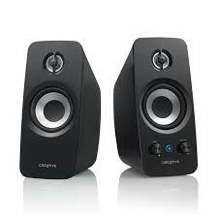
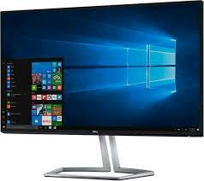
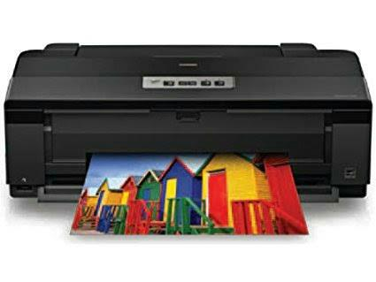
Output Devices
Any device capable of conveying information to a user.
Some output devices are :
Monitors
Printers
Speakers

Slide 2
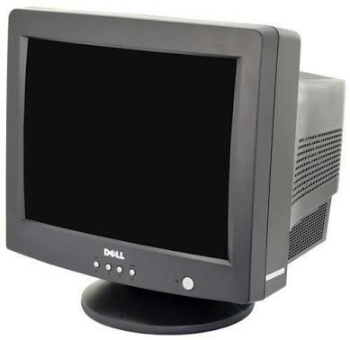
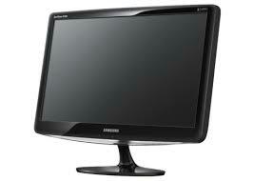
Monitors
A display screen that provides a visual output .
Images are displayed on monitors by individual dots or picture elements called Pixels.
Types of Monitors :
CRT monitor
LCD monitor
LED monitor

Slide 3
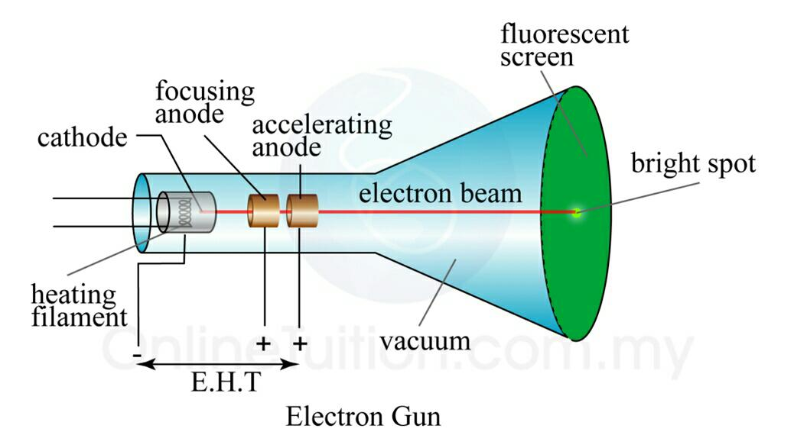
CRT monitors
Stands for Cathode Ray Tube monitor.
Electrons are fired on phosphorous dots on screen.
The dots are grouped into pixels, which glow when stuck by electrons.

Slide 4
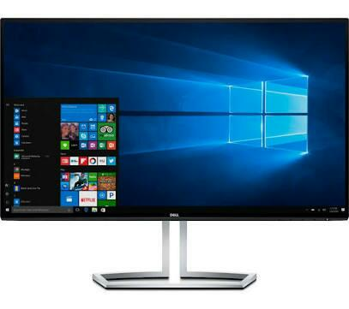
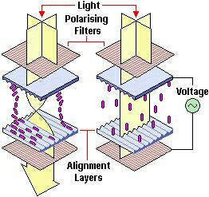
LCD monitors
Stands for Liquid Crystal Display monitor.
Thin, flat panel display device.
Polarization of lights is used to display object.
LCD displays utilize two sheets of polarizing
material with liquid crystal solution between
them.
An electric current passed through liquid crystal.
Each crystal either allow or block the light to pass
through.

Slide 5
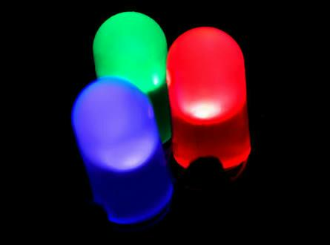
LED monitors
It is Light Emitting Diode (LED) based display.
It is flat panel display.
Matrix of diodes are arranged to form pixels and picture definition is stored in refresh buffer.
Information is read from refresh buffer
and converted into voltage levels that
are provided to diodes, thus providing
light pattern in display.

Slide 6
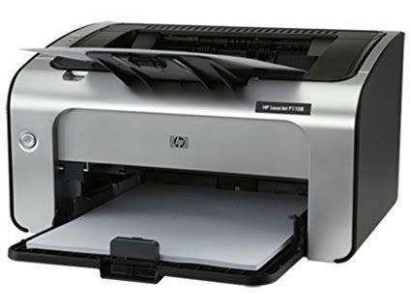
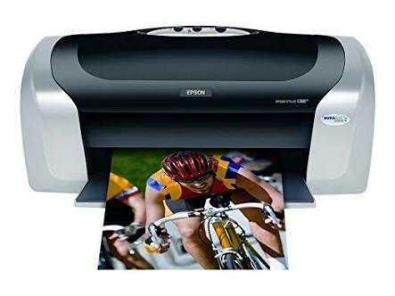
Printers
It is an output device that produce text and graphics on paper.
Some popular printers are :
Laser printer
Ink jet printer
Laser printer Ink jet printer

Slide 7
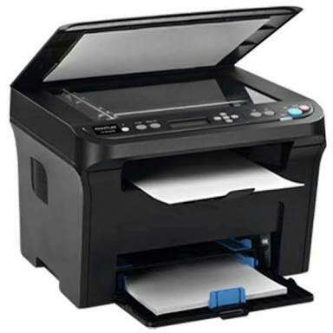
Laser Printer
High speed high quality non-impact printer.
Uses laser beam to transfer images onto printer.
Instead of cartridges, laser printer use toner.
Printing resolution varies between 600-1200 dpi.

Slide 8
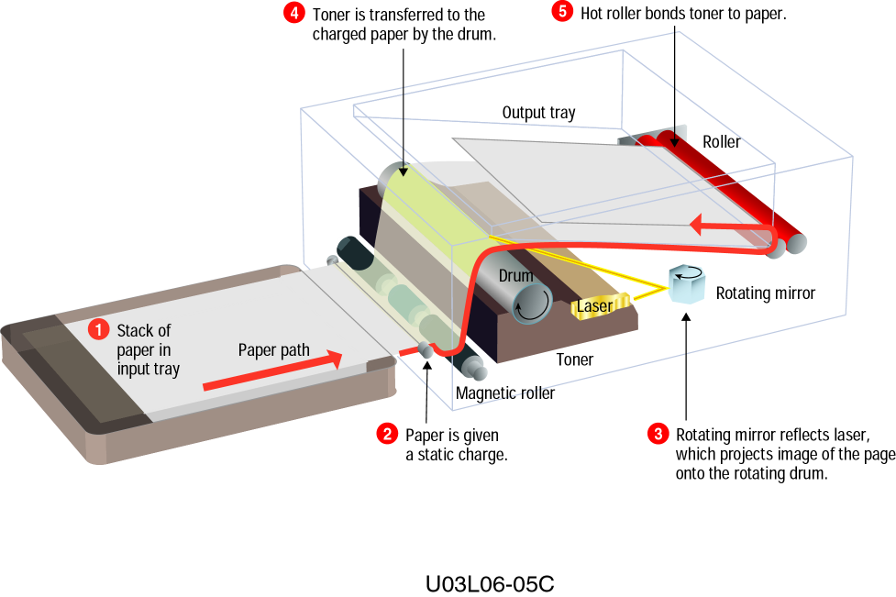
Working

Slide 9
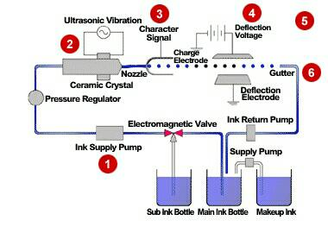
Ink jet Printer
It is a non-impact printer producing a high quality print.
It has resolution between 300-600 dpi.
Ink jet printer sprays ink through small nozzles onto page to produce images.

Slide 10
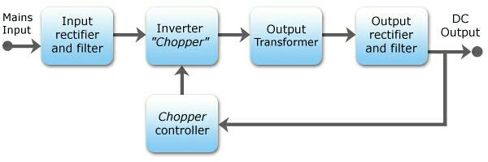
SMPS – Switched Mode Power Supply
Converts the unregulated AC or DC voltage to regulated DC voltage.
Work on the principle of switching regulation.

